Slide 1




ICCS361
DATA MINING PROJECT
NYC Taxi Fare Analysis
PRESENTED BY : CHINANARD SATHITSETH & SAREENA AULLA

Slide 2


TABLE OF CONTENT
01
OVERVIEW OF PROJECT
02
DATA PROCESSING
& PREPARATION
03
DATA VISUALIZATION
04
CONCLUSION

Slide 3
PROJECT UNDERSTANDING
Objective
Analyze the relationship between fare amounts, distance, location, and time to assist customers in decision-making and help taxi companies improve pricing and strategies.
Questions
1. How do average taxi fares vary across different hours and days of the week?
2. How do average travel distances vary by hour of the day across different days of the week?
3. What are the trends in total fare amounts by year and month?
4. Which day has the highest passenger count by each month?
5. How have passenger counts evolved from year to year?

Slide 4
PROJECT UNDERSTANDING: TOOLS
Jupyter Notebook

Slide 5
DATA COLLECTION
Source & Citation
https://www.kaggle.com/competitions/new-york-city-taxi-fare-prediction
Andy Chavez, DJ Sterling, Julia Elliott, Lakshmanan V, Sagar, and Will Cukierski. New York City Taxi Fare Prediction. https://kaggle.com/competitions/new-york-city-taxi-fare-prediction, 2018. Kaggle.

Slide 6

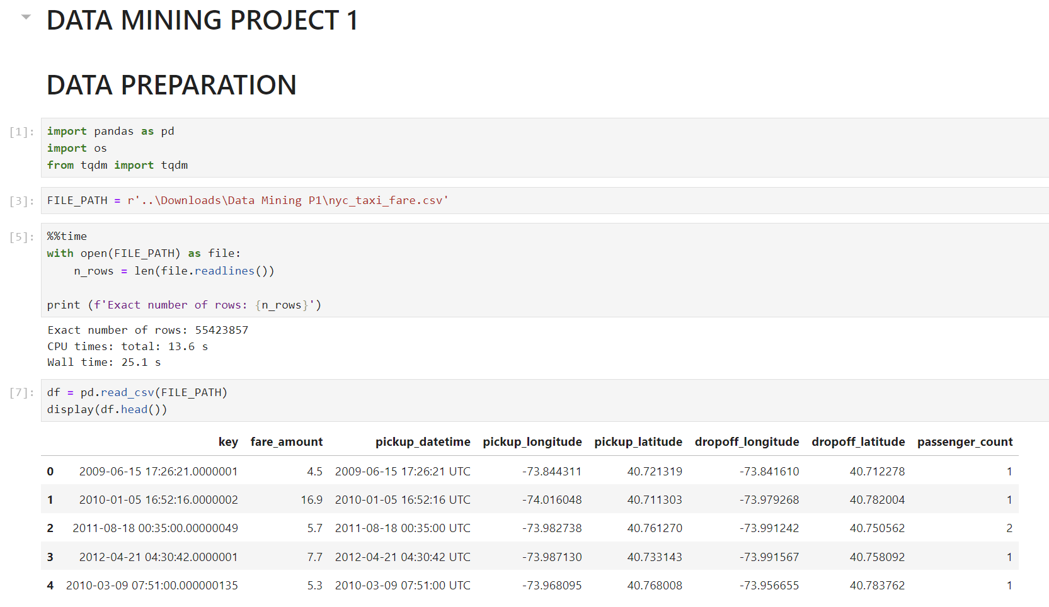
DATA PROCESSING
DATA PREPARATION

Slide 7

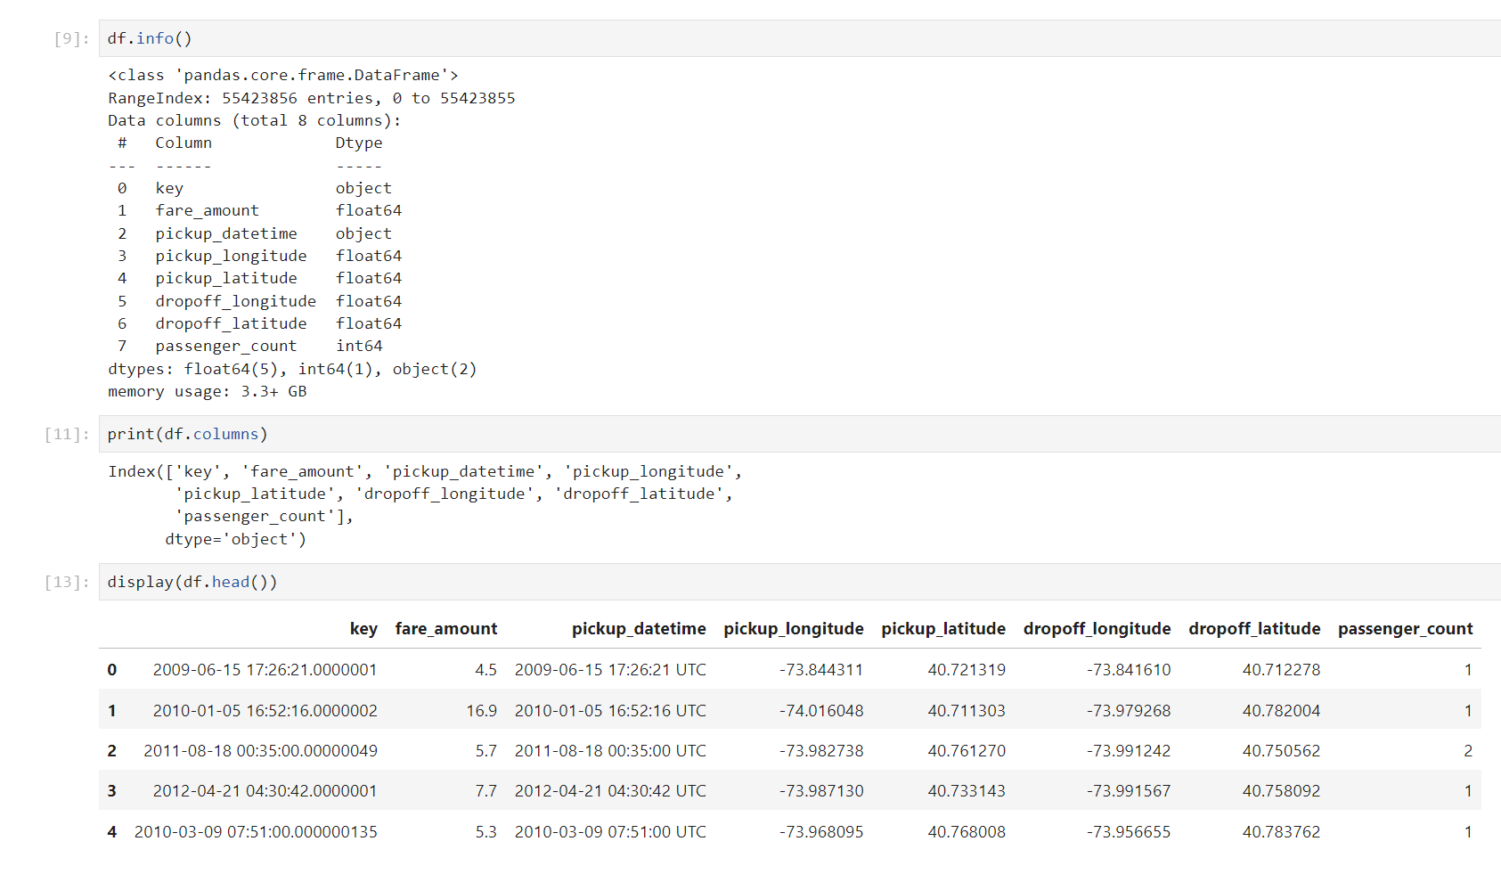
DATA PROCESSING
8 columns
12,000,000 rows

Slide 8
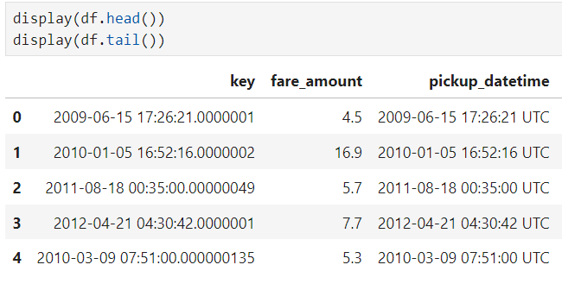
DATA PROCESSING
Date is not sorted
‘key’ and ‘pickup_date’ time are reduntdant

Slide 9
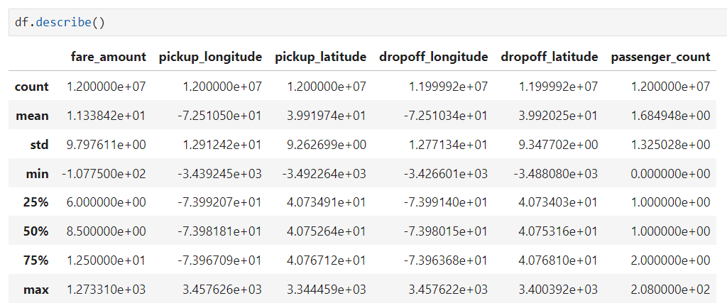
DATA PROCESSING
fare_amount is negative which is not valid

Slide 10
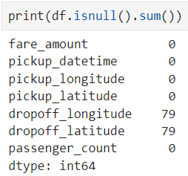
DATA PROCESSING
Out-of-Range Longitude/Latitude & Check missing values
Some longitude/latitude values may not correspond to valid locations in New York City.
source
https://en.wikipedia.org/wiki/New_York_(state)

Slide 11
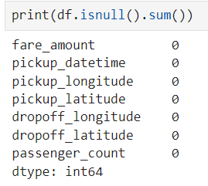


DATA PROCESSING
DATA CLEANSING

Slide 12
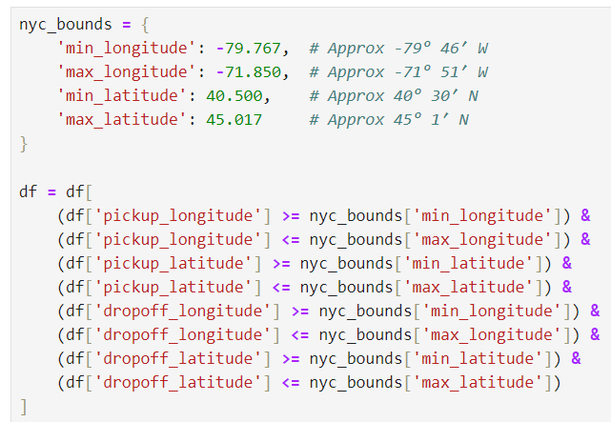
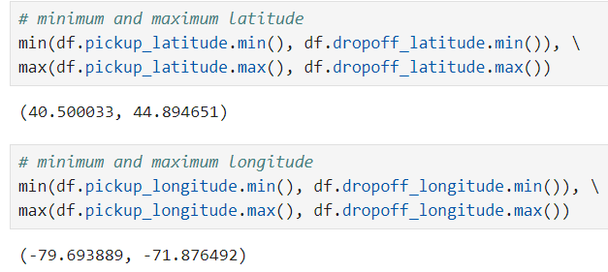

DATA PROCESSING
DATA CLEANSING
set the NYC boundaries
Latitude
Longitude
The boundaries for NYC in this dataset are
Latitude: Between 40.50 and 44.89
Longitude: Between -79.69 and -71.88

Slide 13
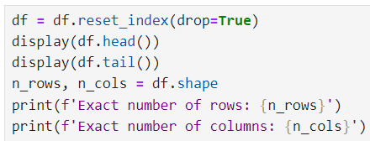
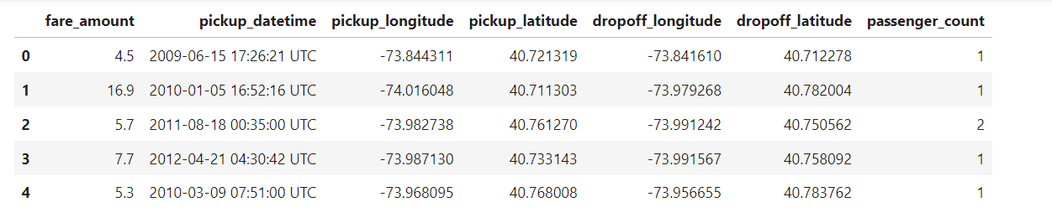
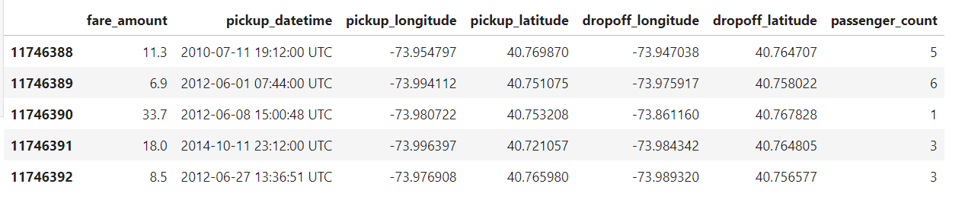
Exact number of rows: 11,746,393
Exact number of columns: 7

Slide 14
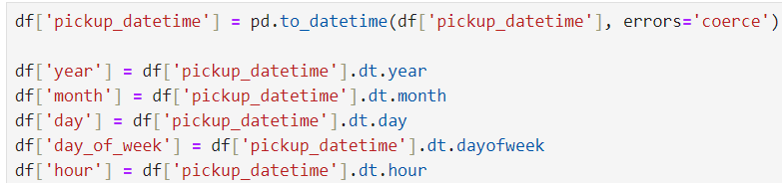
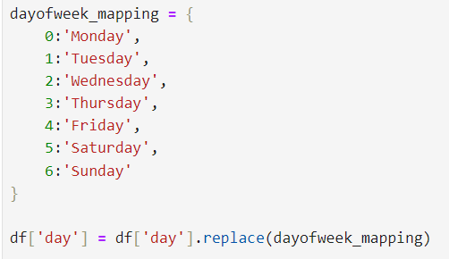
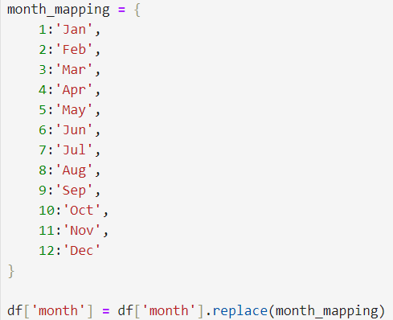
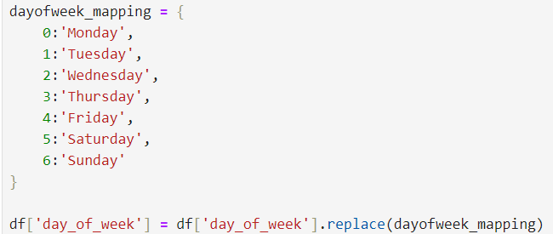

Slide 15

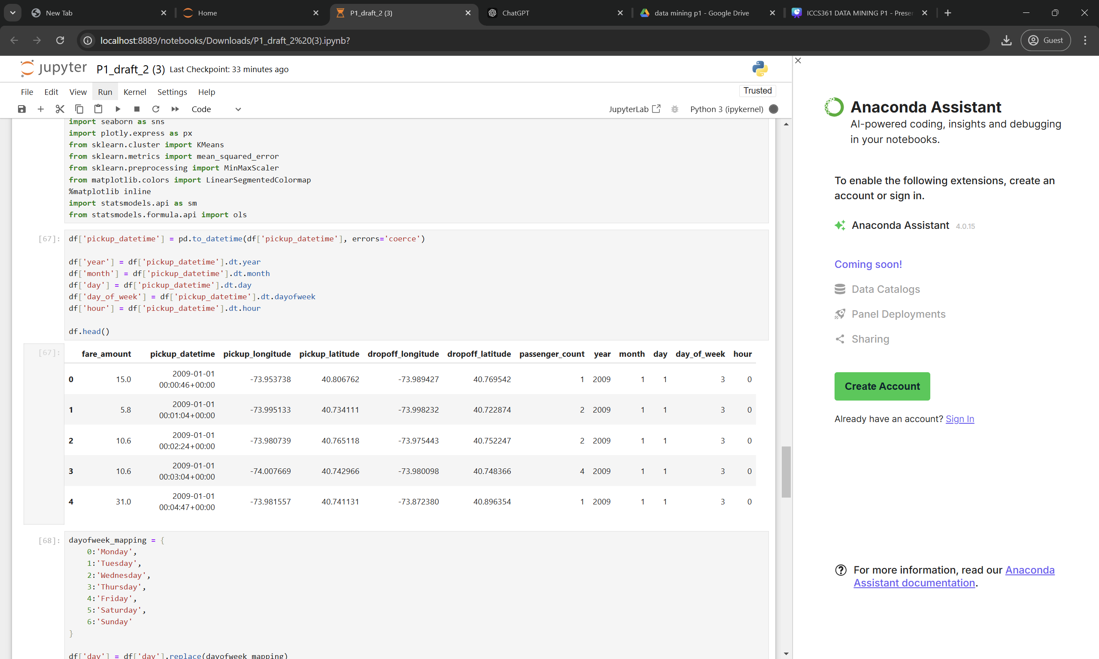

Slide 16
DATA VISUALIZATION
5 Questions

Slide 17
Q 1 : How do average taxi fares vary across different hours and days of the week?
Hypothesis
Null Hypothesis (H0): There is no significant difference in average taxi fares across different hours of the day and days of the week.
Alternative Hypothesis (H1): There is a significant difference in average taxi fares across different hours of the day and days of the week.

Slide 18
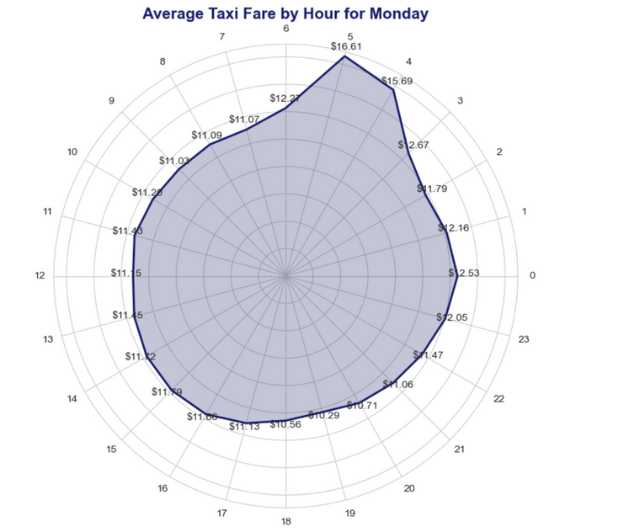
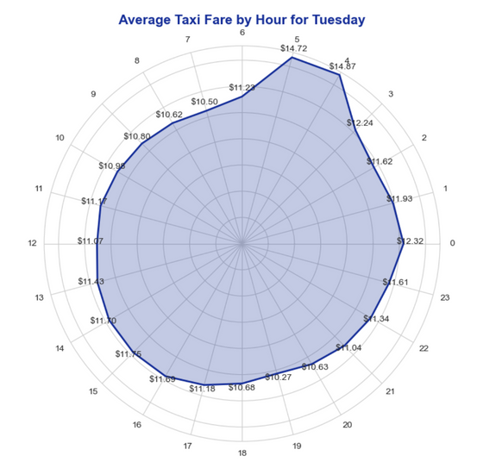
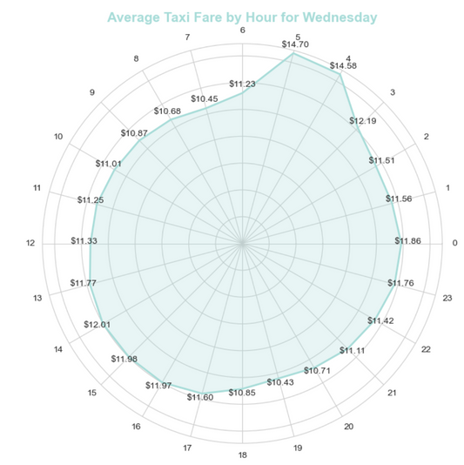
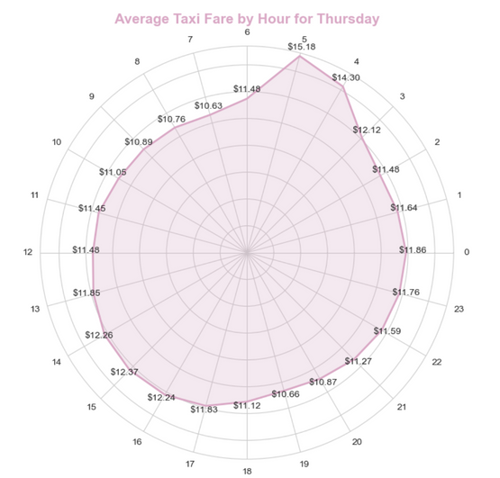
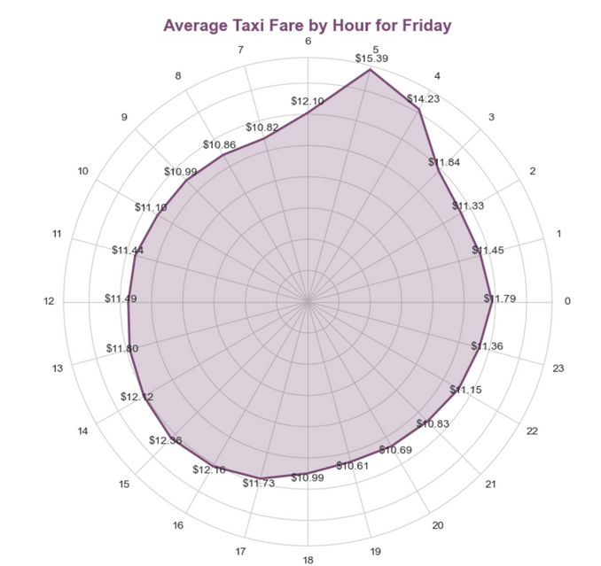
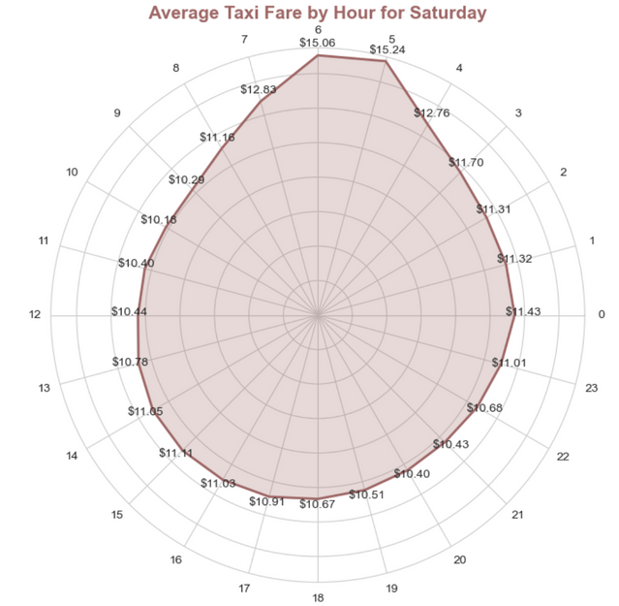
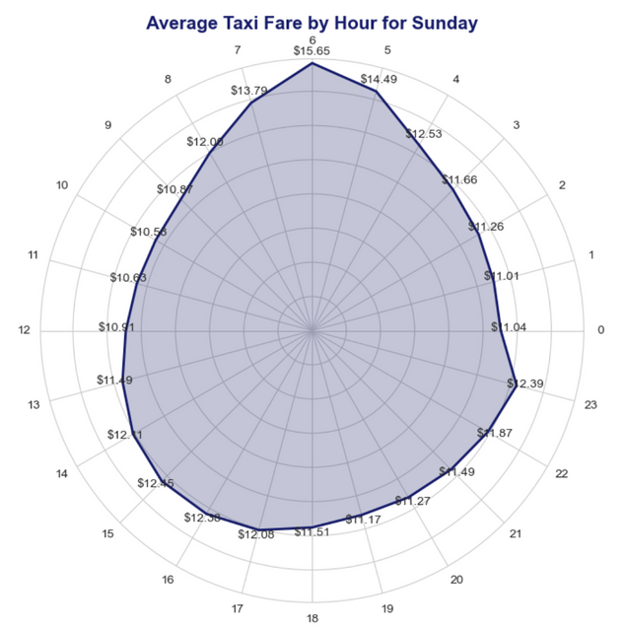
EDA 1
HOW DO AVERAGE TAXI FARES VARY ACROSS DIFFERENT HOURS AND DAYS OF THE WEEK

Slide 19
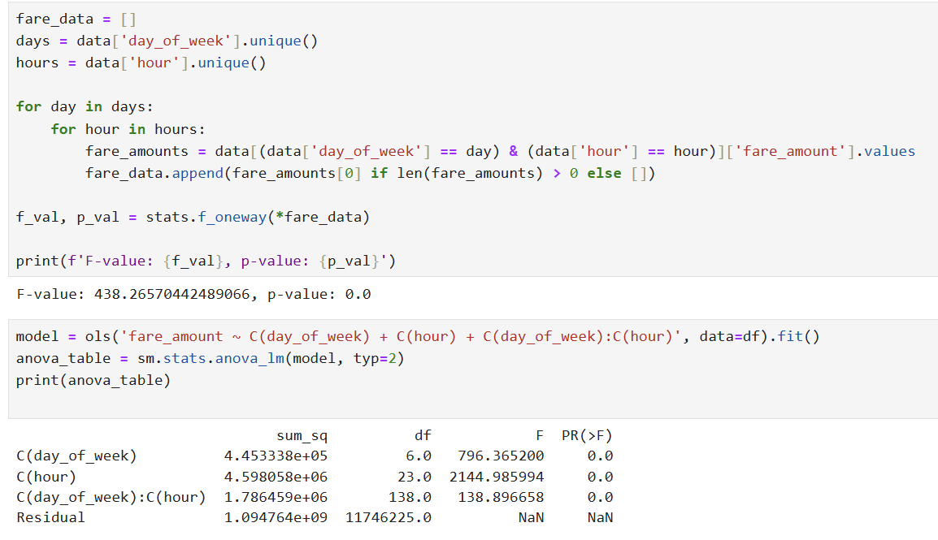
HYPOTHESIS TESTING
Reject the null hypothesis (H0) and since all p-values are 0.0 there are significant differences in average taxi fares across different hours and days of the week.

Slide 20
Q 2: How do average travel distances vary by hour of the day across different days of the week?
Hypotheses
Null Hypothesis (H0): There is no significant difference in average travel distances across different hours of the day and days of the week.
Alternative Hypothesis (H1): There is a significant difference in average travel distances across different hours of the day and days of the week.

Slide 21
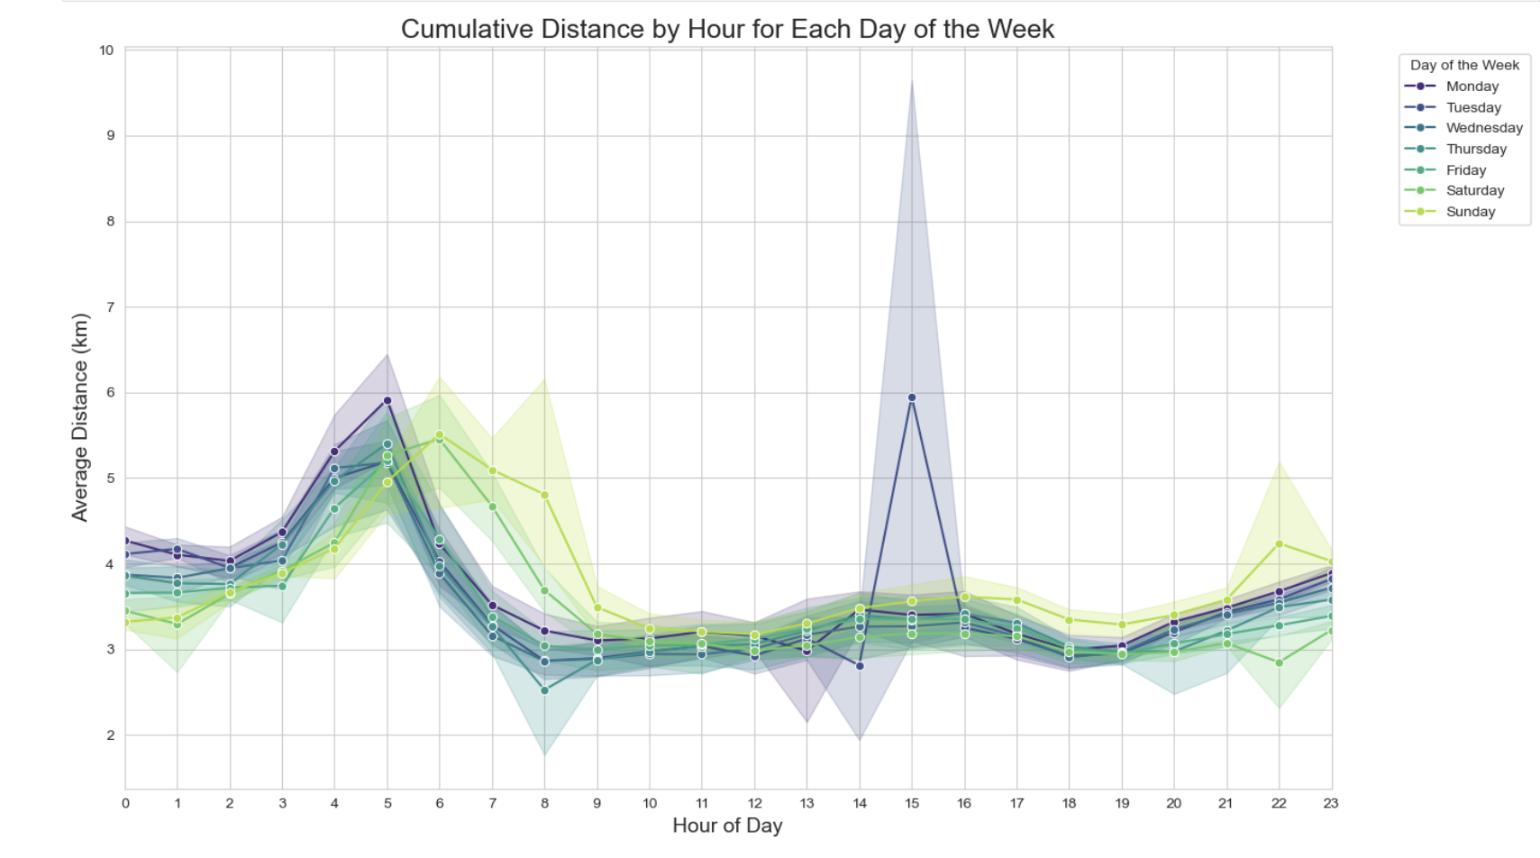
EDA 2
HOW DO AVERAGE TRAVEL DISTANCES VARY BY HOUR OF THE DAY ACROSS DIFFERENT DAYS OF THE WEEK?

Slide 22
HYPOTHESIS TESTING
Reject the null hypothesis (H0) and since all p-values are 0.0 there is a significant difference in average travel distances across different hours of the day and days of the week.

Slide 23
Q 3: What are the trends in total fare amounts by year and month?
Hypotheses
Null Hypothesis (H0) : There is no significant trend in total fare amounts by year and month.e.
Alternative Hypothesis (H1) : There is a significant trend in total fare amounts by year and month.

Slide 24

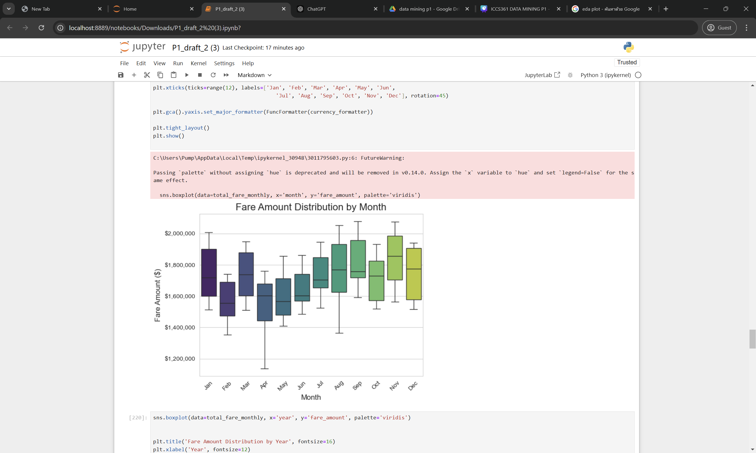
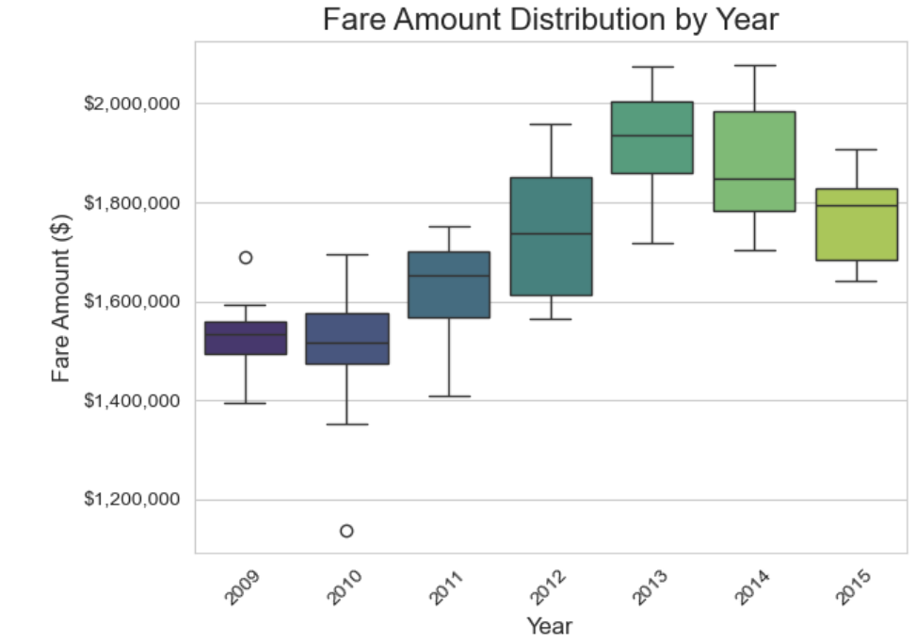
EDA 3
WHAT ARE THE TRENDS IN TOTAL FARE AMOUNTS BY YEAR AND MONTH?

Slide 25
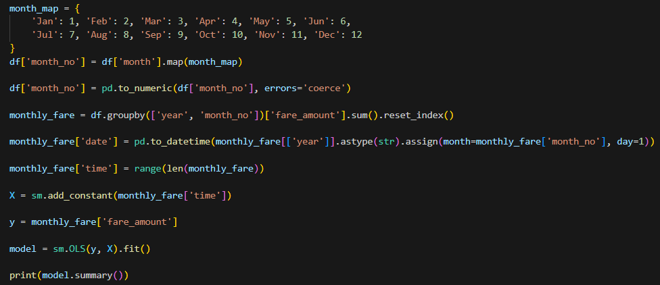
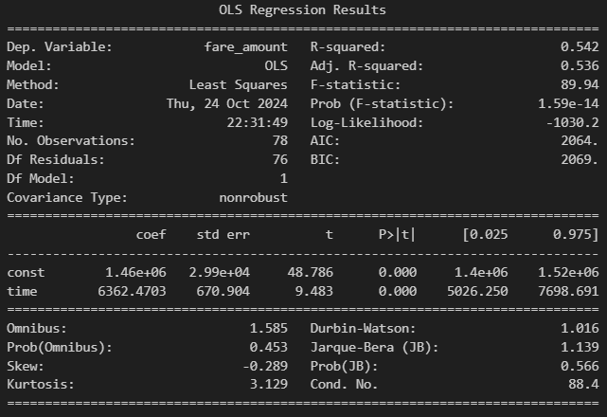
HYPOTHESIS TESTING
H0 : There is no significant trend in total fare amounts by year and month, meaning fare amounts do not change systematically over time.
H1 : There is a significant trend in total fare amounts by year and month, indicating systematic changes over time.
Reject the null hypothesis (H0) and since all p-values are 0.0 there is a significant trend in total fare amounts by year and month.

Slide 26
Q 4: Which day has the highest passenger count by each month?
Hypotheses
Null Hypothesis (H0) : There is no significant difference in passenger count across different days of the week for each month.
Alternative Hypothesis (H1) : There is a significant difference in passenger count across different days of the week for each month.

Slide 27
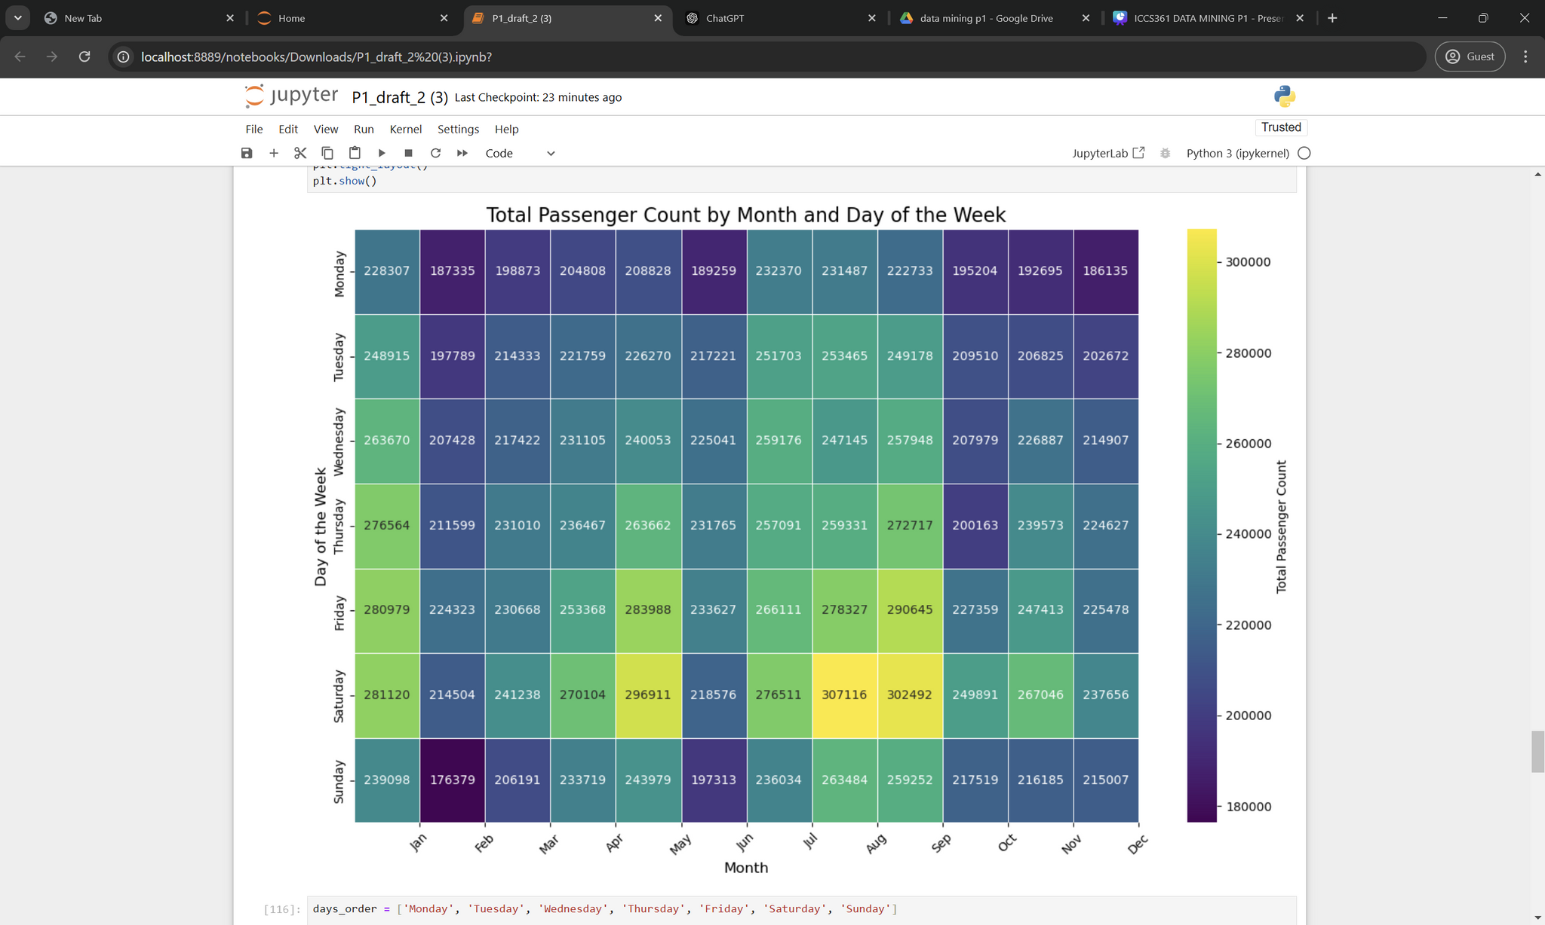
EDA 4
WHICH DAY HAS THE HIGHEST PASSENGER COUNT BY EACH MONTH?

Slide 28
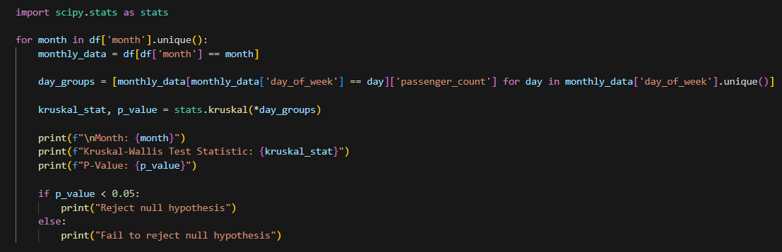
HYPOTHESIS TESTING

Slide 29
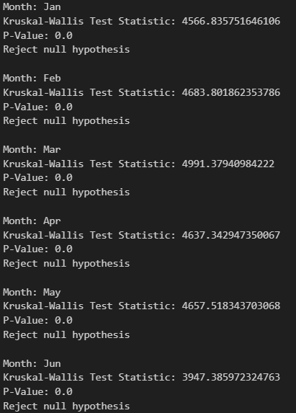
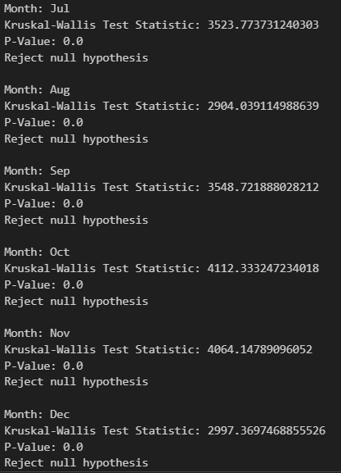
HYPOTHESIS TESTING
Reject the null hypothesis (H0) and since all p-values are 0.0 There is a significant difference in passenger count across different days of the week for each month.

Slide 30
Q 5: Q5 How have passenger counts evolved from year to year?
Hypotheses
Null Hypothesis (H0) : There is no significant change in the number of passengers over time.
Alternative Hypothesis (H1) : There is a significant change in the number of passengers over time.

Slide 31
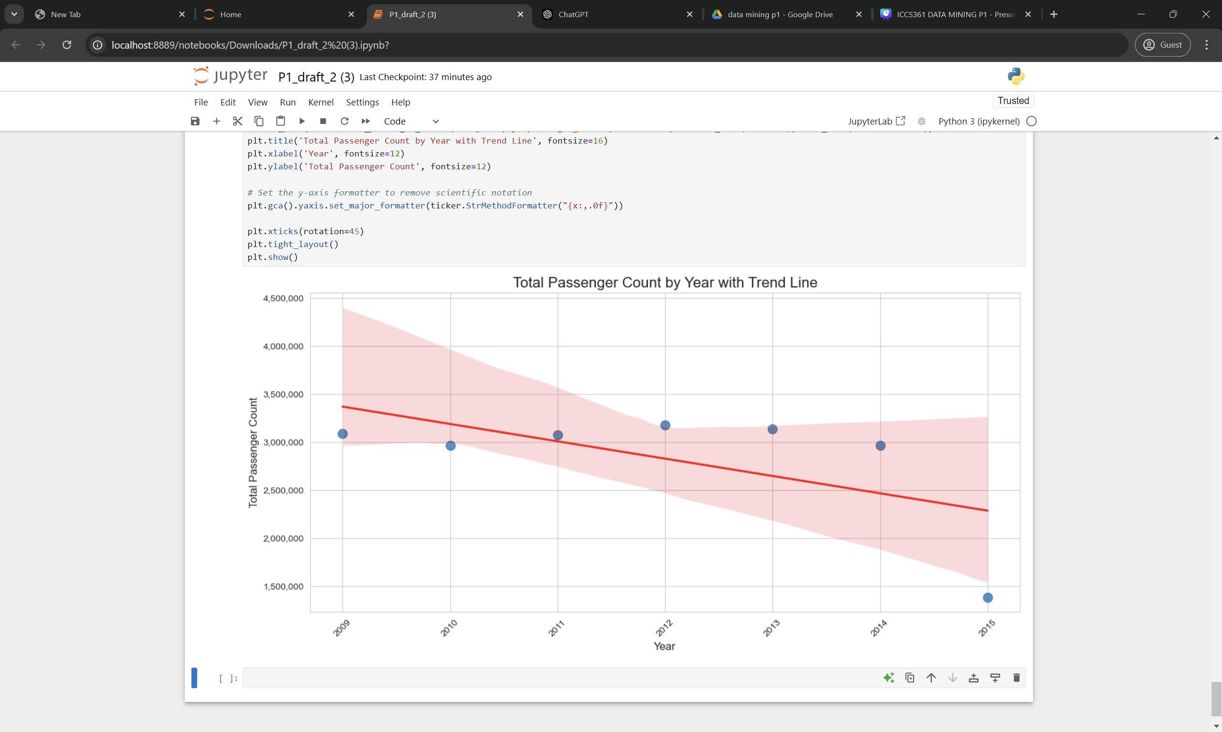
EDA 5
WHAT IS THE AVERAGE NUMBER OF PASSENGERS CHANGING OVER TIME?

Slide 32
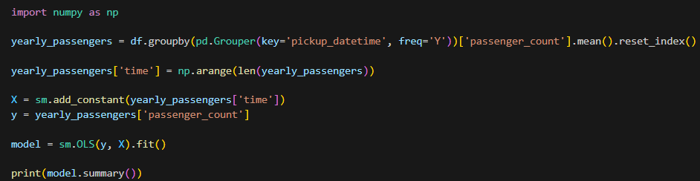
HYPOTHESIS TESTING

Slide 33
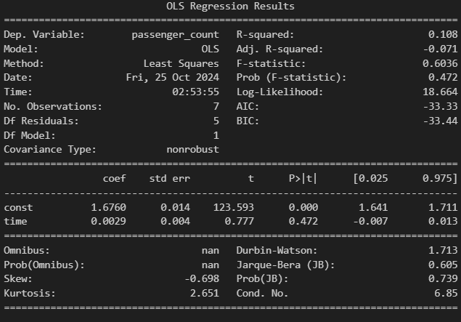
HYPOTHESIS TESTING
Reject the null hypothesis (H0) and since all p-values < 0.05 There is a significant change in the number of passengers over time.

Slide 34
CONCLUSION

Slide 35


Overall, the analysis shows significant yearly changes in taxi fares.
Higher fare amounts are influenced by distance and areas with traffic congestion.
The data suggests that people still take taxis even for shorter distances. Over the years, passenger numbers initially increased, then declined, likely due to rising fare costs.

